Slide 1

GOVERNMENT SCHEME APPLICATION SYSTEM

Slide 2
TEAM MEMBERS :
FENIL SHAH
SAURABH JOSHI
SHANTANU KAUSHIK
SOURABH WATTAMWAR
SUKRITA MOHANDOSS
SURABHI KURIYAL
VARUN SHARMA
DIVIYANSHA AGARWAL

Slide 3
APPLICATION FEATURES :
FOR EMPLOYEE :
Employee Login
Add, Edit and Update Schemes
Logout
FOR CITIZEN :
Citizen Registration
Citizen Login
View and Apply to Schemes
Edit and Update Citizen Details
Logout

Slide 4
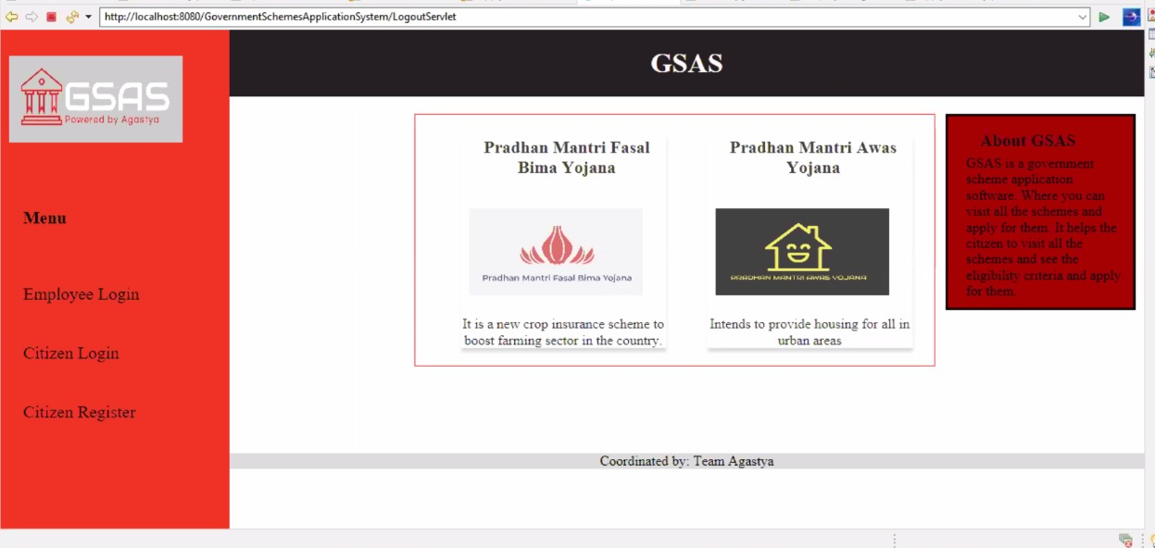
UI SNAPSHOTS :

Slide 5
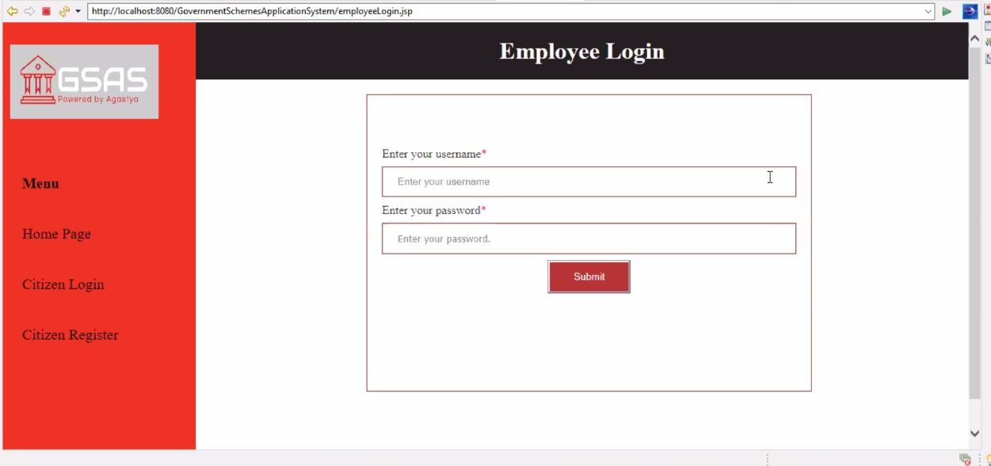
UI SNAPSHOTS :

Slide 6
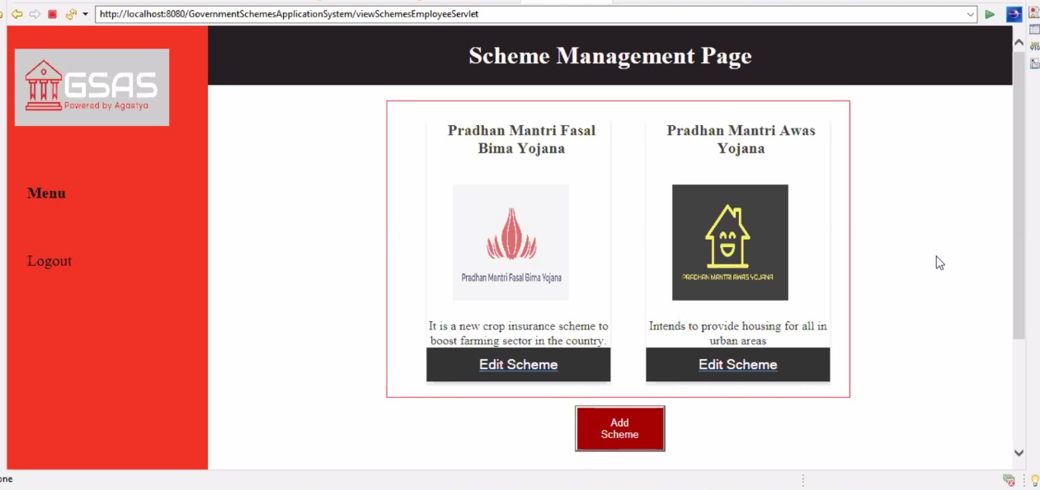
UI SNAPSHOTS :

Slide 7
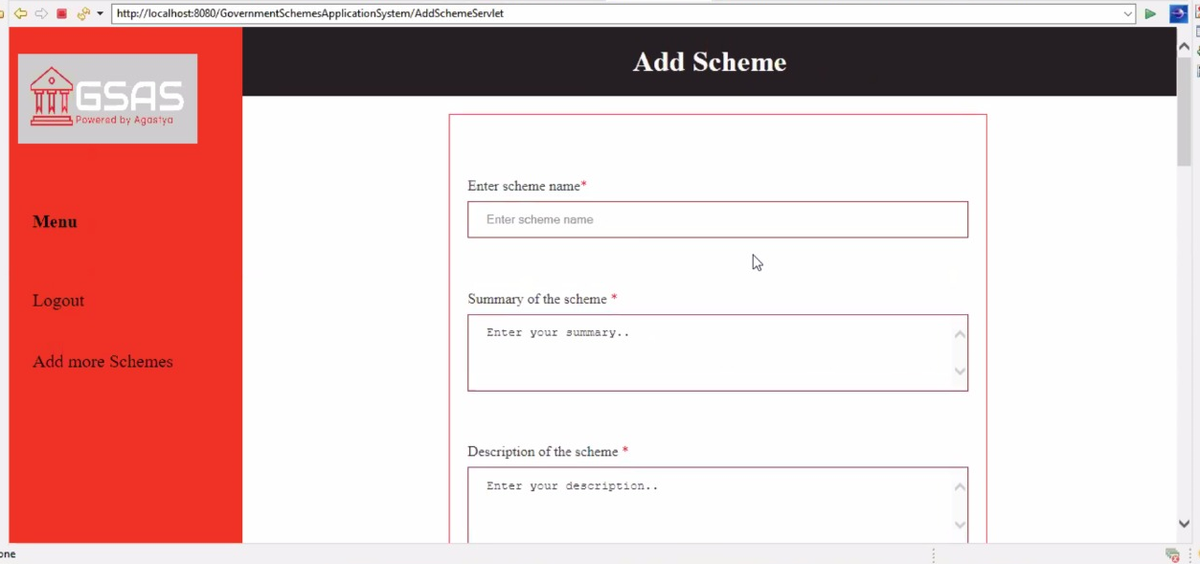
UI SNAPSHOTS :

Slide 8
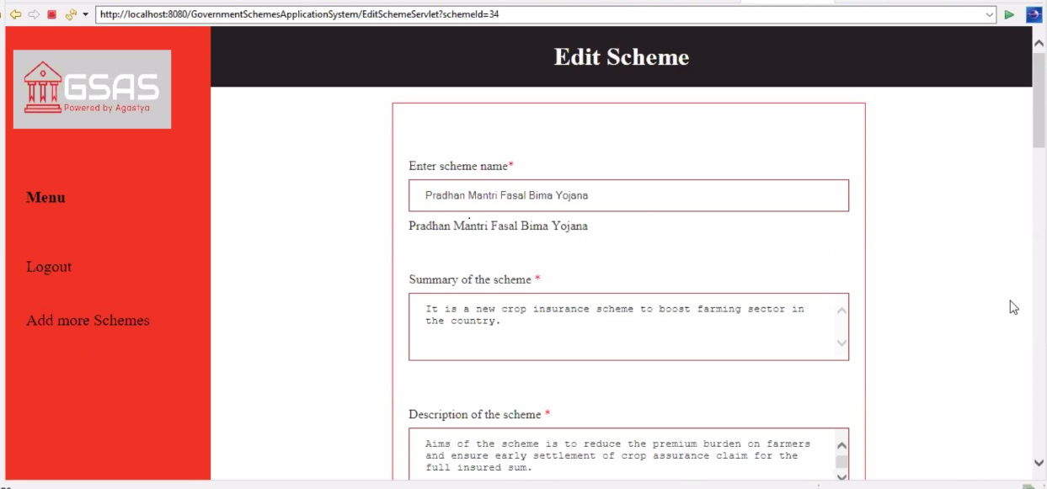
UI SNAPSHOTS :

Slide 9
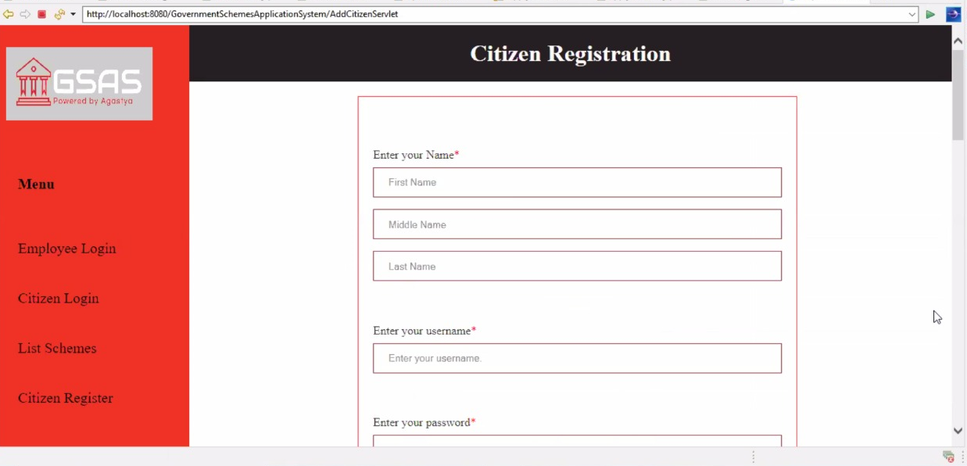
UI SNAPSHOTS :

Slide 10
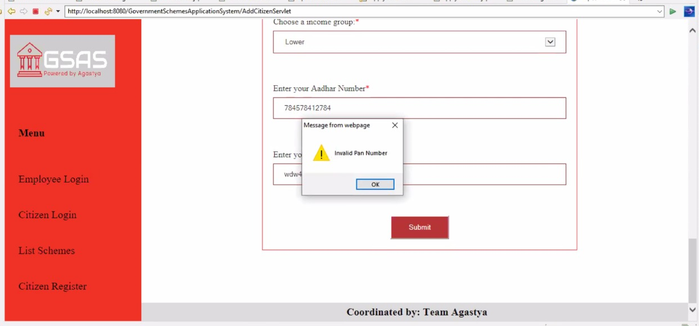
UI SNAPSHOTS :

Slide 11

UI SNAPSHOTS :

Slide 12
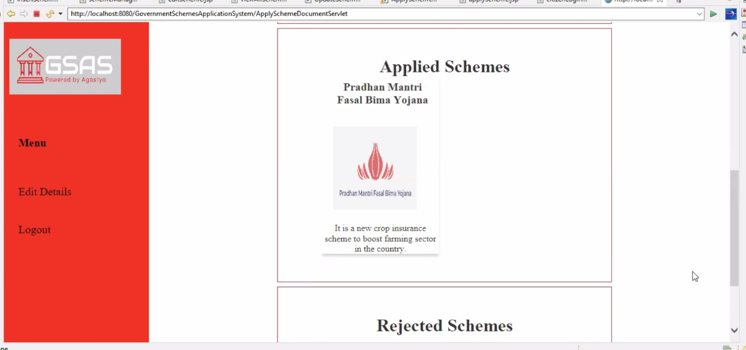
UI SNAPSHOTS :

Slide 13
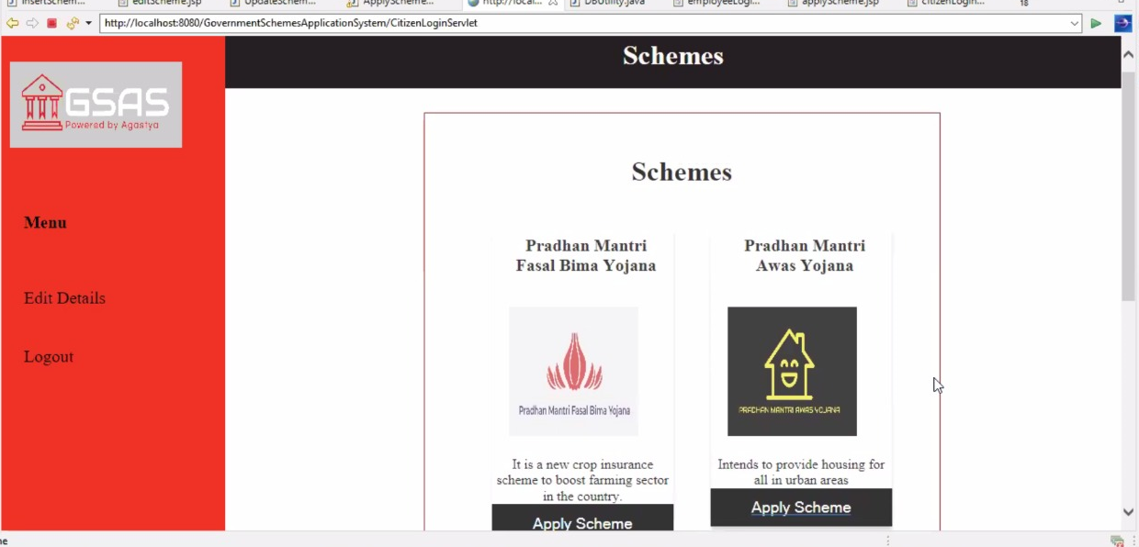
UI SNAPSHOTS :

Slide 14
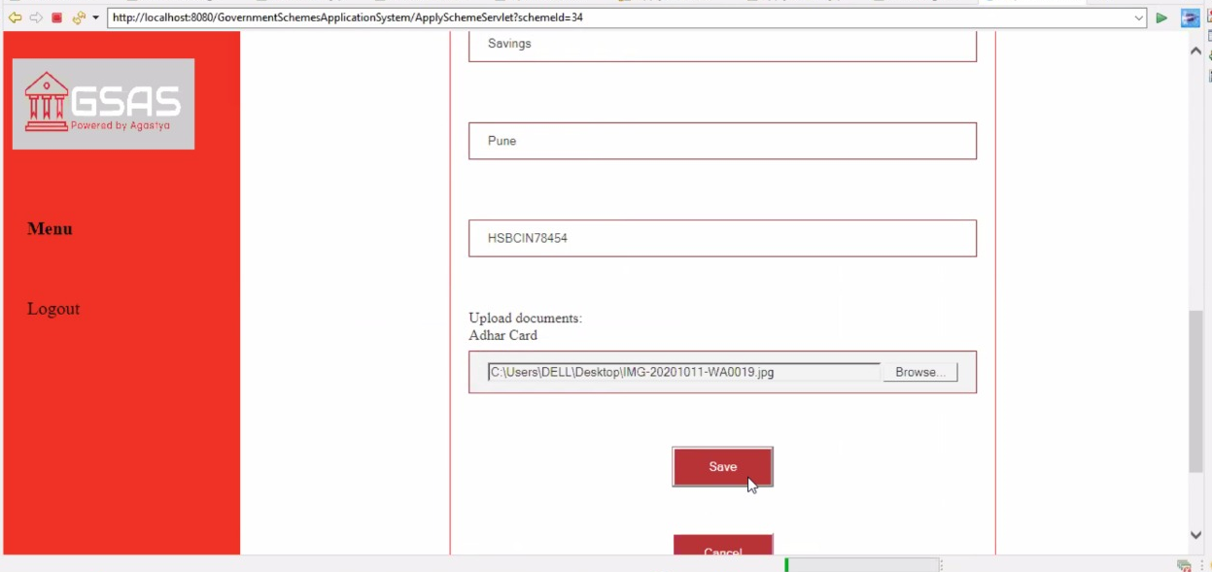
UI SNAPSHOTS :

Slide 15

UI SNAPSHOTS :

Slide 16
CONCEPTS USED :
Model View Controller Architecture
Java
Servlets
Exception Handling
Database Management
JSP
HTML
CSS

Slide 17
TOOLS USED :
Eclipse Version 4.16.0
Apache Tomcat Version 8.5
Derby Database

